Slide 1

Commanders Request Mast Program
Unclassified
Mr. Elliott
Command Inspector General
Updated 5 Feb 2024
Distribution Statement A. Approved for public release: distribution is unlimited.
Unclassified

Slide 2

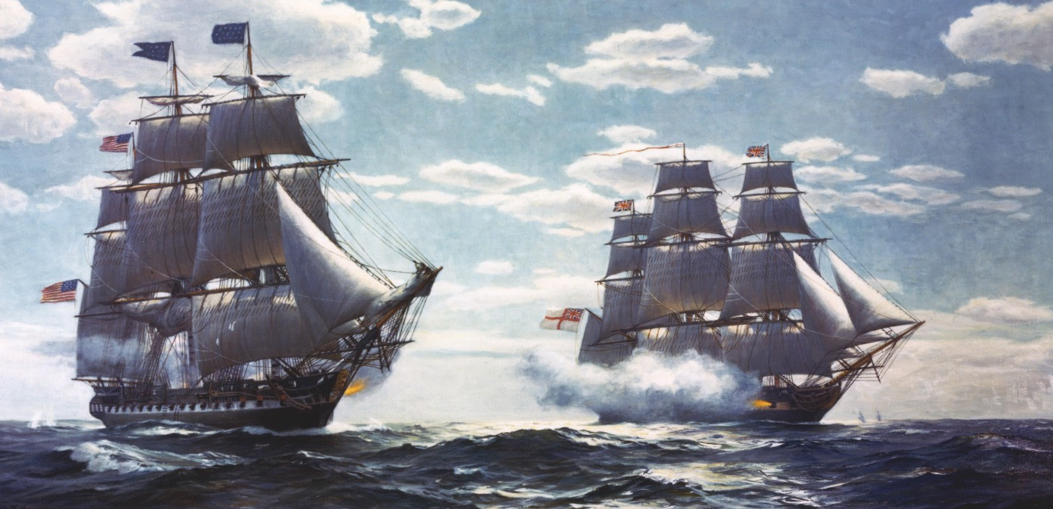
Agenda
Request Mast Agenda
History & purpose of Mast
Policy for Requesting Mast
Procedures for Requesting Mast
Assistance

Slide 3

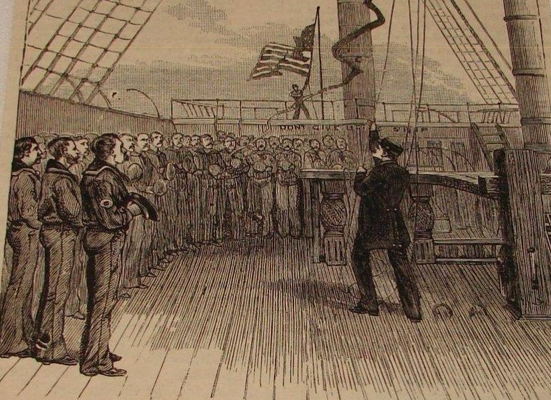
History of Mast
Naval tradition
Commander’s interaction with ship’s crew
Dispense punishment
Present awards
Accept grievances
Ship’s crew had guaranteed right to speak to their Commander
Solutions were not assured

Slide 4


Purpose of mast
Convey grievances directly to the Commander
Provide a more personal conversation with Commander*
Expedite processing of urgent concerns
Should employ the entire Chain of Command to assist
Should not dismiss the “Chain of Concern
Should not replace established staff functions
Should never supplant informal discourse
* Appearance with Commander should not present a conflict of interest or affect neutrality

Slide 5
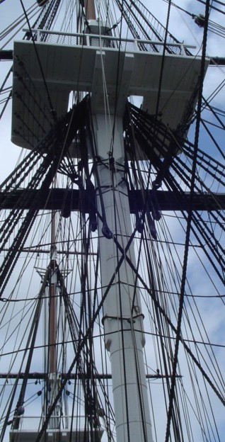
Request Mast policy
According to Marine Corps Order 1700.23G, it is "the right of all Marines to directly seek assistance from, or communicate grievances to, their commanding officers." A Marine has "the opportunity to communicate not only with his or her immediate commanding officer, but also with commanders up to and including a Commanding General (CG) within the chain of command at the same base or immediate geographical location.“
MCO 1700.23G
NAVMC 11296 (form)
Are there better avenues of redress?
Not appropriate for Mast:
  Nuisance requests
  Matters dealing w/ UCMJ or ADSEP
    Contemplated, pending, in progress, or final
  Administrative Actions
  Performance Evaluation

Slide 6







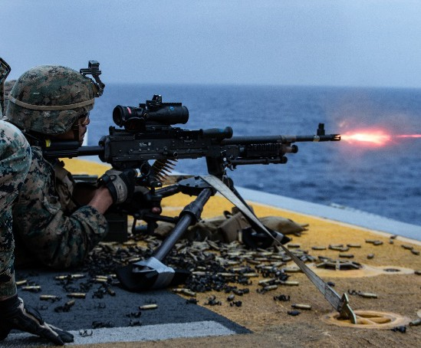
Chain of command
Who can I request mast to?
Systems Company Commander
H&S Battalion Commander
Commander, MARCORSYSCOM

Slide 7
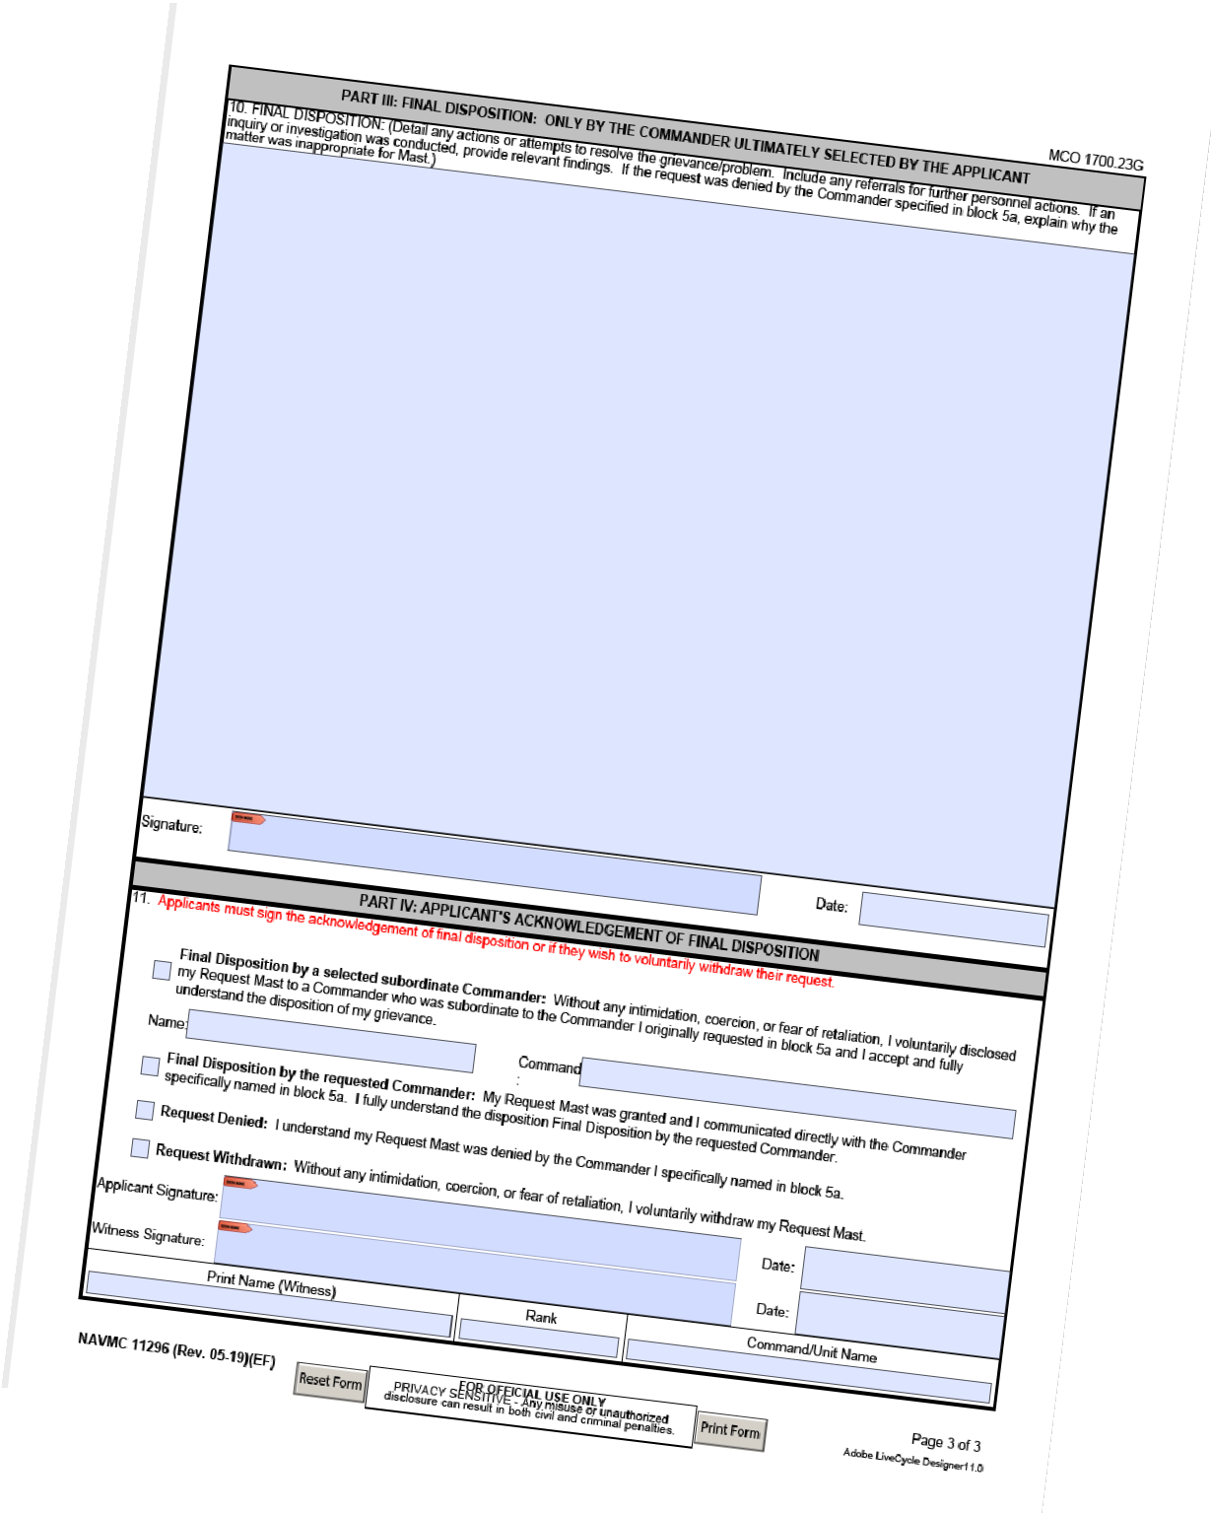
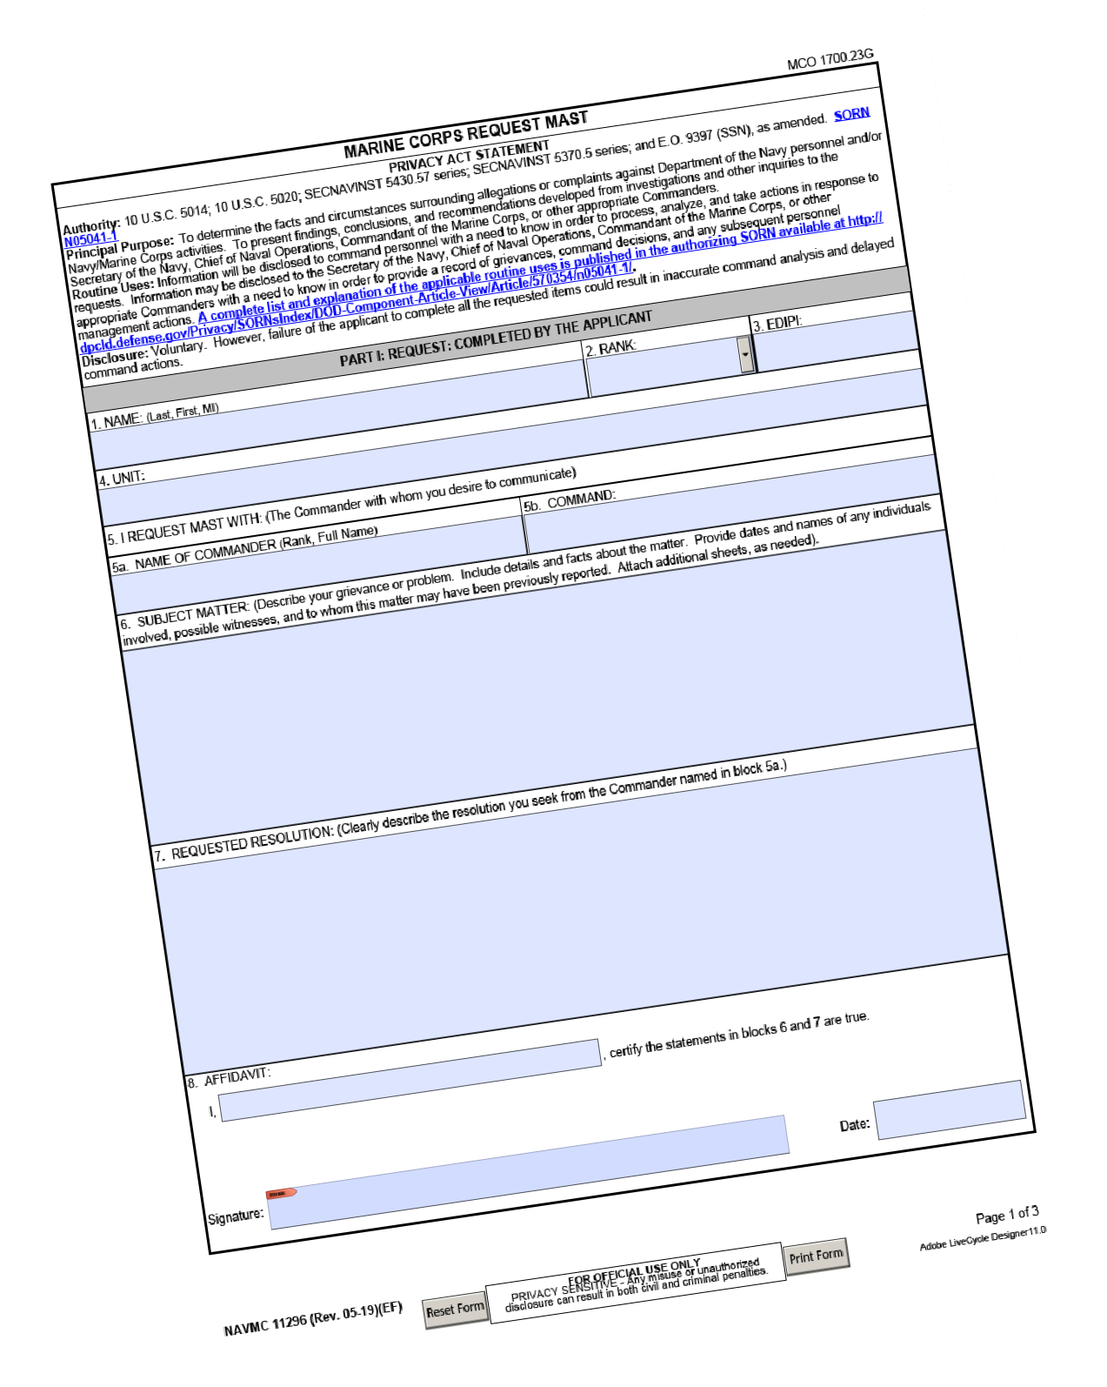
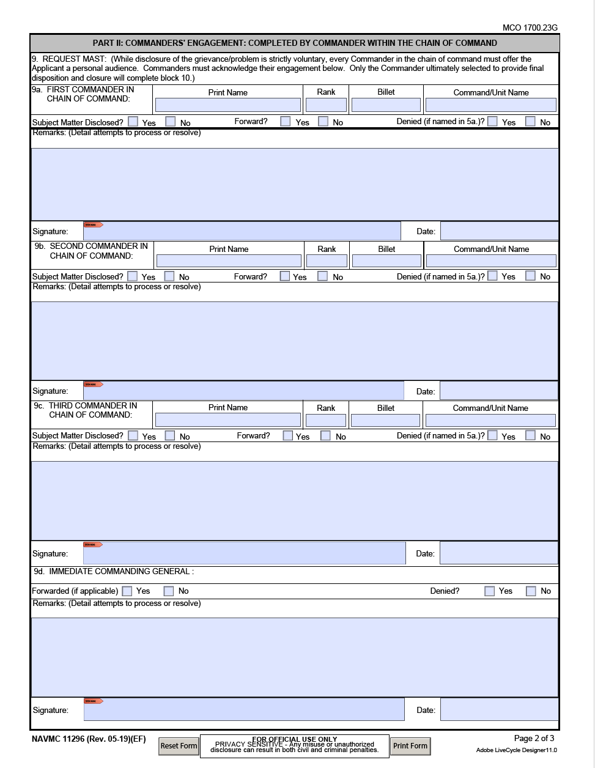

Request mast procedure
NAVMC 11296 (5-19)
Filled out, signed, & dated
Role of the Applicant
Be a truthful provider of facts
Forward via the chain of command
If applicant does not want to disclose the matters, place in a secured envelope and write, “TO BE OPENED BY (RANK NAME or CG) ONLY”

Slide 8
Request mast procedure
Role of the “Chain of Concern”
Leaders at all levels should assist the Marine or Sailor with completing the NAVMC
Expedite request
Do not stop Mast and try to resolve it
Role of the Chain of Command
Expedite audience with the Commander
  Typically, the commander will hear the Mast within (1) business day
If disclosed, try to resolve at the lowest level of command
Explain disposition, delays, and denials
  A face-to-face explanation may not be required for some denials
The Commander will notify the CG if it is denied
Ensure no adverse or prejudicial action is taken against a Marine as a result of exercising the right to request Mast

Slide 9
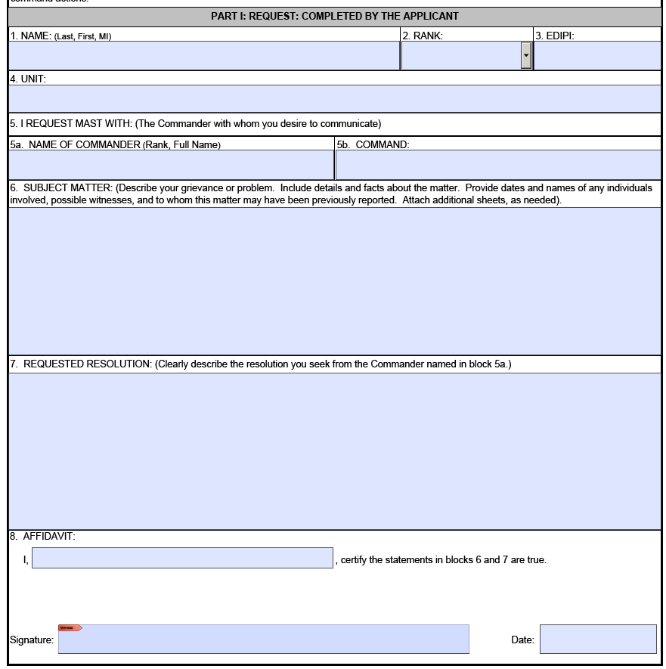




Request mast procedure
unclassified
Personal, contact, and biographical data
Which Commander is requested?
What is the problem?
What is the desired “solution”?
Legal affidavit must be signed
and dated.
“Starts the Clock”
unclassified

Slide 10

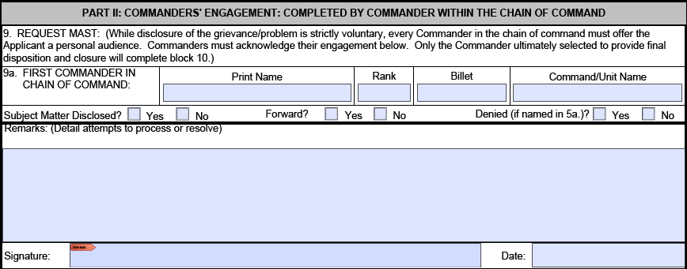


Request mast procedure
unclassified
Each Commander’s data
Answer
Commander must sign and date
Commanders NOT taking final disposition shall complete part II
If Marine accepts a subordinate commander from the commander in block 5a, accepted commander can skip Part II and go to Part III
unclassified

Slide 11
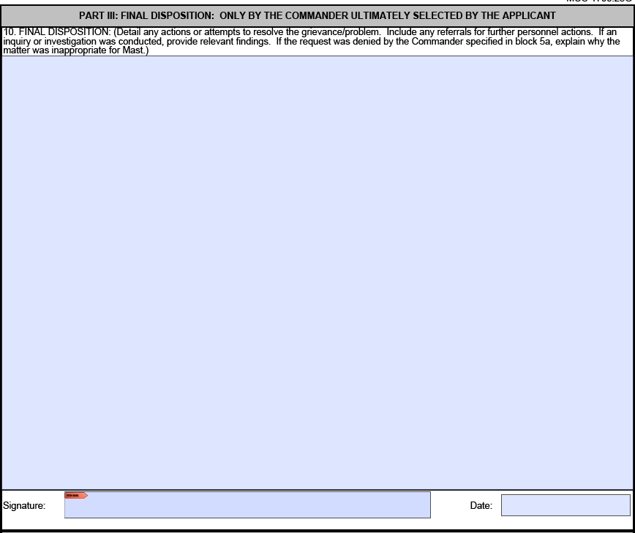


Request mast procedure
unclassified
Final disposition; issue may not be resolved immediately
Final Commander to engage with Applicant. Sign & date, stops the clock
unclassified

Slide 12

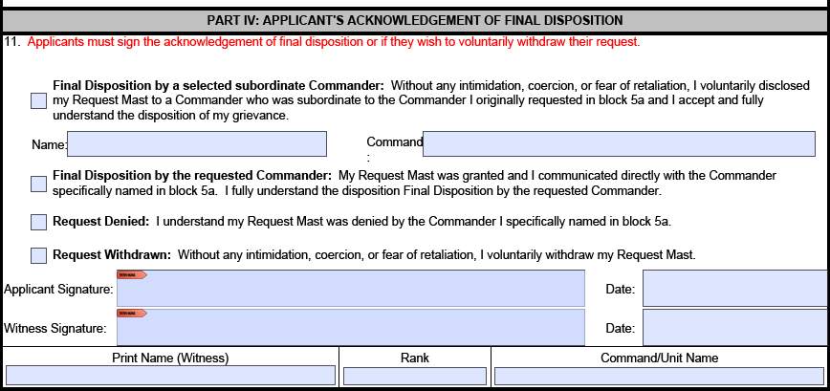





Request mast procedure
unclassified
Applicant selects one
acknowledgement
Applicant and witness
sign and date.
If a subordinate commander, to the commander in block 5a, is accepted by the Marine and resolves the issue, that subordinate commander is acknowledged in Part III and the Request for Mast is NOT forwarded any higher. ONLY Commanders can be acknowledged in Part III.
unclassified

Slide 13
Assistance
Marines, Sailors, or Officers needing assistance with completing the NAVMC 11296 can contact the chain of command or:
First Sergeant
Sergeant Major
Executive Officer
OTHER POCs (e.g. S-1 Chief, EOR, Platoon Sergeant)
Command Inspector General
  703-432-4483

Slide 14
unclassified
unclassified

