Slide 1
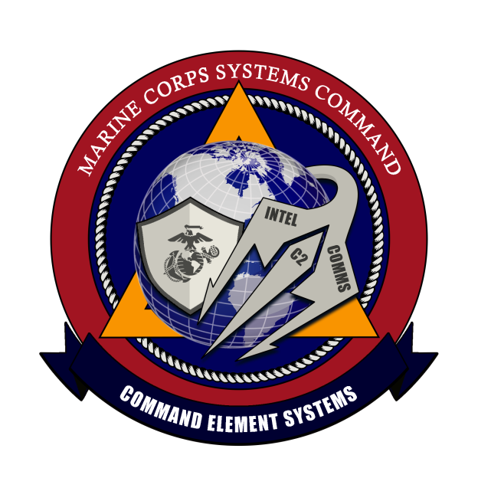
PORTFOLIO MANAGEMENT OFFICE
COMMAND ELEMENT SYSTEMS
Portfolio Manager: Col D. B McDaniel
Mission: Provide and Sustain Command & Control, Communications and Intelligence Capabilities to the MAGTF.
DISTRIBUTION STATEMENT A. Approved for public release. Distribution is unlimited.

Slide 2
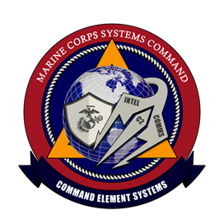
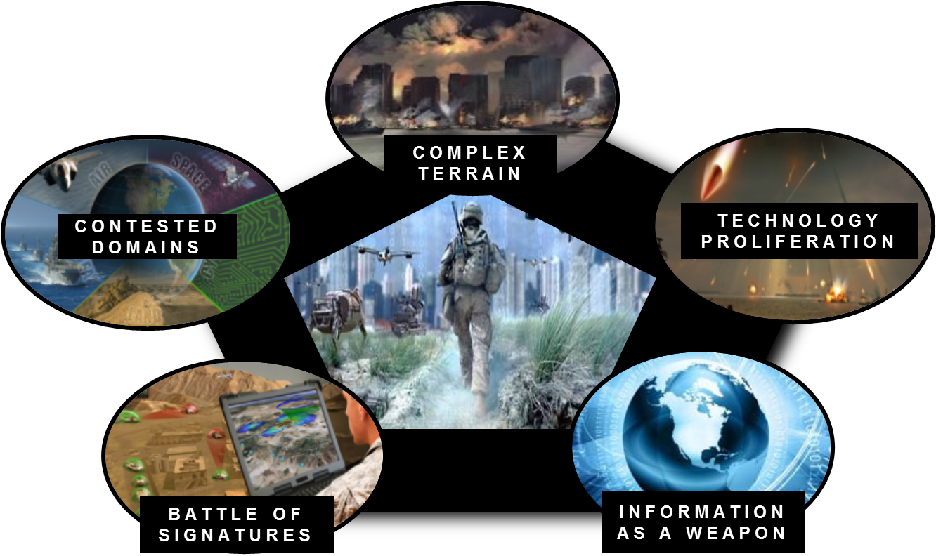

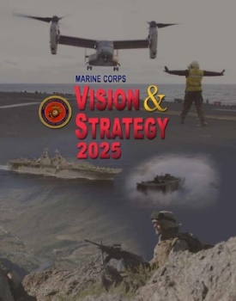
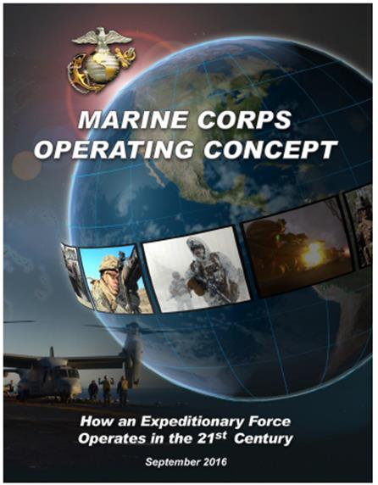
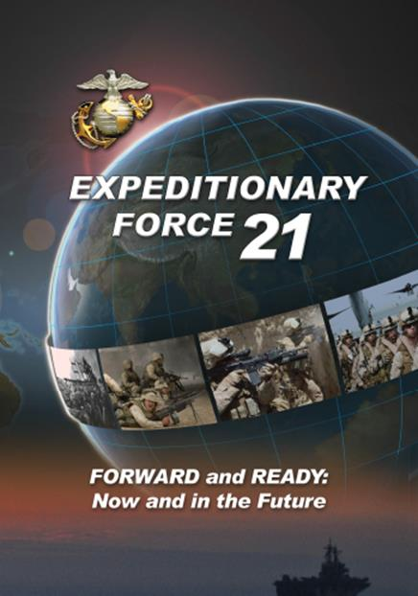
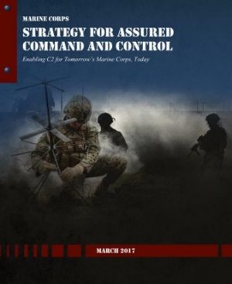
Command Element Systems
“No single activity in war is more important than command and control.” - MCDP 6
Future “Five Drivers of Change”
“C2 is a function of a commander’s ability to sense, make sense of, and act upon information. As a modern force, we must continue to put ourselves into position to gain all the possible advantages of networking.”
PM Command and Control Systems
PM Communications Systems
PM Intelligence Systems
“We will seek to exploit all the advantages conferred by richly networked communications and attempt to deny those same advantages to the enemy.”
“The MAGTF must draw on the full portfolio of U.S. intelligence systems, including space-based assets, to build and maintain an accurate, current, and actionable operational knowledge base. ” - MOC

Slide 3
PfM CES Portfolio Overview

Slide 4
CES Organization
Command Element Systems (CES)
Portfolio Manager (PfM)
Col Donald B. McDaniel
Deputy Portfolio Manager (DPfM)
Mr. James Westerholm
Program Manager (PM)
Intelligence Systems (IS)
Col Dave Burton
Program Manager (PM)
Command & Control Systems (C2S)
LtCol Antonio Scoffield
Program Manager (PM)
Communications Systems (CS)
LtCol Bert Rakdham
Deputy Program Manager (DPM)
Mr. Michael Stanford
Deputy Program Manager (DPM)
Ms. Deborah Fountain-Yates
Deputy Program Manager (DPM)
Mr. Harry Downey
Electronic Warfare Systems
LtCol Thomas Dono
Command & Control
Infrastructure & Services
Mr. Joseph Murgo
Expeditionary
Communications
Vacant
Distributed Common
Ground/Surface Systems
Mr. Thomas Roebuck (acting)
Joint Battle Command –
Platform
Mr. Brian Havener
Ground Radios
LtCol Jeffrey Decker
Terrestrial/Human
Intelligence
Mr. John Covington (acting)
Extensible MAGTF
Command & Control
Mr. Basil Moncrief
Satellite Communications
Mr. Terry Ritchie
Signals Intelligence
LtCol Patrick Collins
Information Related
Capabilities
LtCol Douglas Peterson
Terrestrial High Capacity
Communications
Mr. Steven Batts
Identity Operations
Ms. Sarah Swift
Tactical Networking
Mr. John Norris
Radars
Mr. Frank Mello (acting)

Slide 5
PfM CES Opportunities
Areas Where Industry Can Help
  Cyber Security
  Reduce Size, Weight, and Power
  Signature Management
  Converging Capabilities
  Reducing Costs

Slide 6
PM IS Programs
PfM CES
PM IS
Intelligence Systems
PM C2S
Command and Control Systems
PM CS
Communications Systems
S&T
Science & Technology
EWS
CAP
CVRJ (V)2
MFEW
MEG FoS (F)
Modi II
SSF (F)
VSI
DCGS-MC
All Source (F)
IAS FoS FY16-21
GEOINT
TEG RWS
SIGINT (F)
EMC2
NOTM-A Inc1
NOTM-A Inc2
NOTM GCV
NOTM-UTV
JBC-P
JBC-P FoS
JBC-P VMS
MCH
MCH-ECR
MCH-RFES
Radars
AN/TPS-59A(V)3
AN/TPS-59 Sustainment
AN/TPS-59 ADATR
AN/TPS-59 DREX
AN/TPS-59 Mode 5 IFF
Array Drive
Auto North
FMS Cases (18) (International Program)
DREX
Fleet Support
FMS (18 cases)
IFF Antenna
Mech Enhancements
Mode 5
Mode 5 Level 2
PDSS
Row Transmitter
Transport Shelter AN/TPS-63B
EXCOMM
COMSEC (E)
DAGR
MGUE (F)
SPEED/NPM (E)
GR
HFR
HFR II
IISR
MBR
MBR II
MCR FoS
SINCGARS (E)
THHR
THHR (V) 3
THHR-SVA
AMWS (IS)
Antenna Electrocution (CS)
Artificial Intelligence/Machine Learning INP (C2S)
Beyond Line Of Sight Communications (CS)
CRIT (IS)
Data in Transit Algorithms (C2S)
EAITE (C2S)
ENDOR FNC (IS)
Incadence Advanced Biometrics Device (IS)
Information Assurance Multilevel Security (C2S)
Innovative Algorithms (IS)
LPI/LPD (CS and C2S)
LRI/LPD Communications for HiMAR (GCES & FSS)
UES TFT (IS & C2S)
IRC
CCS FoS
MARCIMS
MISO FoS
PAS
THC2
AN/TRC-170
AN/MRC-142B
AN/MRC-142C
AN/MRC-142D
FSO (F)
LOS-R
NGT
TEAMS
TSSR (E)
WPPL-D
WPPL
SIGINT
CESAS II
CEMOS (F)
EMSOR
IBR
SIGMAN (F)
TCAC 4.6/4.7
TPCS MPC Refresh
TSCS
C2IS
GCSS-TCO
JTCW
TSOA
T/HUMINT
  CIHEP FY14/15
  CIHEP Next Gen (F)
  GBOSS
  MSIDS
  MSIDS Next Gen (F)
  MSWS
  TRSS V6.1
  TSCM
TACNET
COC(V) 1-4 FoS
DDSM/CDN
DDSM/SFF
TVSS
WIDe
IdOps
EFEC
EFEC Inc 2 (F)
IDS-MC
IDS-MC Inc 2
SATCOM
GBS
SCI-COMMS HBSI-PT
SMART-T AEHF UG
SWAN/VSAT FoS L/M/S
VSAT-E
Last Reviewed: Jan 2019. (E) indicates effort (not a program); (F) indicates future program
FOUO (U)

Slide 7
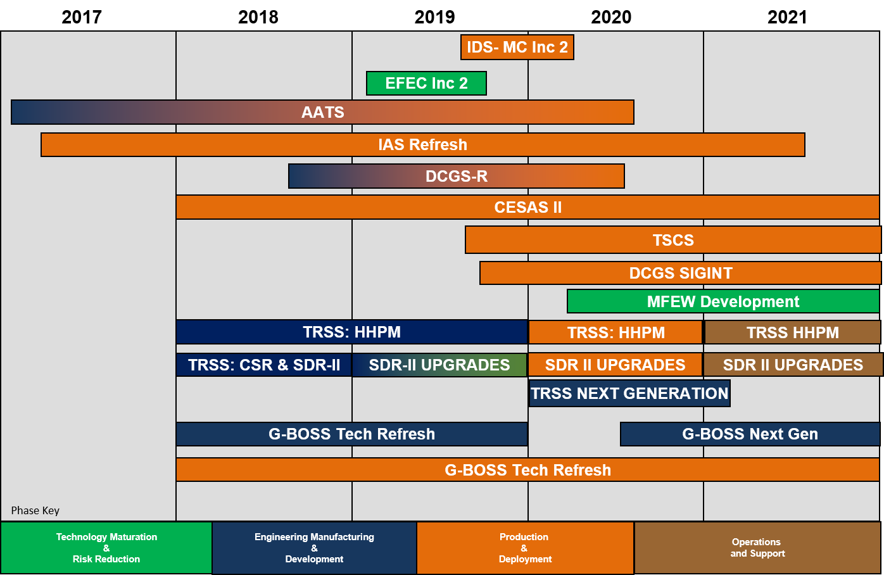
PM IS Business Opportunities

Slide 8
PM IS Business Opportunities
Title | Planned RFP
IDS-MC Increment II Production RFP | 4QFY19
EFEC Increment II RIF BAA | 2QFY19
Common Intelligence Server Refresh | 3QFY19
IAS Refresh | 2QFY17 – 2QFY20
DCGS Marine Corps GEOINT-Refresh (DCGS-R) | 2QFY19
CESAS II Man Packable Production | 4QFY19
TSCS Components | 4QFY19
DCGS SIGINT Components | 4QFY19
Multi-Function Electronic Warfare | 2QFY20
G-BOSS Tech Refresh | FY18 – FY20
TRSS-Common Sensor Radio | FY19 – FY20
TRSS-Hand Held Program Monitor (HHPM) | FY19
TRSS-SDR Upgrades | FY19
TRSS-Next Generation | FY20
G-BOSS Next Generation | FY21

Slide 9
PM C2S Programs
PfM CES
PM IS
Intelligence Systems
PM C2S
Command and Control Systems
PM CS
Communications Systems
S&T
Science & Technology
EWS
CAP
CVRJ (V)2
MFEW
MEG FoS (F)
Modi II
SSF (F)
VSI
DCGS-MC
All Source (F)
IAS FoS FY16-21
GEOINT
TEG RWS
SIGINT (F)
EMC2
NOTM-A Inc1
NOTM-A Inc2
NOTM GCV
NOTM-UTV
JBC-P
JBC-P FoS
JBC-P VMS
MCH
MCH-ECR
MCH-RFES
Radars
AN/TPS-59A(V)3
AN/TPS-59 Sustainment
AN/TPS-59 ADATR
AN/TPS-59 DREX
AN/TPS-59 Mode 5 IFF
Array Drive
Auto North
FMS Cases (18) (International Program)
DREX
Fleet Support
FMS (18 cases)
IFF Antenna
Mech Enhancements
Mode 5
Mode 5 Level 2
PDSS
Row Transmitter
Transport Shelter AN/TPS-63B
EXCOMM
COMSEC (E)
DAGR
MGUE (F)
SPEED/NPM (E)
GR
HFR
HFR II
IISR
MBR
MBR II
MCR FoS
SINCGARS (E)
THHR
THHR (V) 3
THHR-SVA
AMWS (IS)
Antenna Electrocution (CS)
Artificial Intelligence/Machine Learning INP (C2S)
Beyond Line Of Sight Communications (CS)
CRIT (IS)
Data in Transit Algorithms (C2S)
EAITE (C2S)
ENDOR FNC (IS)
Incadence Advanced Biometrics Device (IS)
Information Assurance Multilevel Security (C2S)
Innovative Algorithms (IS)
LPI/LPD (CS and C2S)
LRI/LPD Communications for HiMAR (GCES & FSS)
UES TFT (IS & C2S)
IRC
CCS FoS
MARCIMS
MISO FoS
PAS
THC2
AN/TRC-170
AN/MRC-142B
AN/MRC-142C
AN/MRC-142D
FSO (F)
LOS-R
NGT
TEAMS
TSSR (E)
WPPL-D
WPPL
SIGINT
CESAS II
CEMOS (F)
EMSOR
IBR
SIGMAN (F)
TCAC 4.6/4.7
TPCS MPC Refresh
TSCS
C2IS
GCSS-TCO
JTCW
TSOA
T/HUMINT
  CIHEP FY14/15
  CIHEP Next Gen (F)
  GBOSS
  MSIDS
  MSIDS Next Gen (F)
  MSWS
  TRSS V6.1
  TSCM
TACNET
COC(V) 1-4 FoS
DDSM/CDN
DDSM/SFF
TVSS
WIDe
IdOps
EFEC
EFEC Inc 2 (F)
IDS-MC
IDS-MC Inc 2
SATCOM
GBS
SCI-COMMS HBSI-PT
SMART-T AEHF UG
SWAN/VSAT FoS L/M/S
VSAT-E
Last Reviewed: Sept 2018. (E) indicates effort (not a program); (F) indicates future program
FOUO (U)

Slide 10
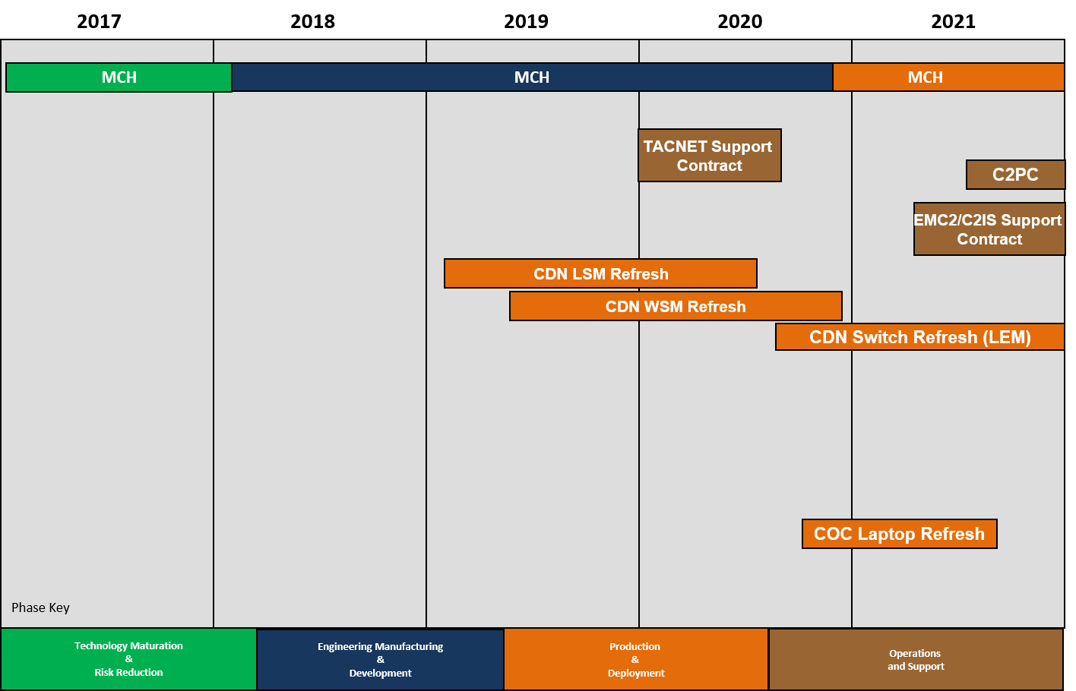
PM C2S Business Opportunities

Slide 11
PM C2S Business Opportunities
Title | Planned RFP
CDN LAN Services Module (LSM) Refresh | 3QFY19
CDN WAN Services Module (WSM) Refresh | 1QFY20
CDN Switch Refresh (LEM) | 4QFY20
COC Laptop Refresh | 4QFY20
TACNET Program Support | 3QFY19
Command and Control Personal Computer (C2PC) (SW development/support) (TSOA influenced) | 4QFY20
C2IS/EMC2 Program Support | 1QFY21
IRC Program Support | 2QFY19

Slide 12
PM CS Programs
PfM CES
PM IS
Intelligence Systems
PM C2S
Command and Control Systems
PM CS
Communications Systems
S&T
Science & Technology
EWS
CAP
CVRJ (V)2
MFEW
MEG FoS (F)
Modi II
SSF (F)
VSI
DCGS-MC
All Source (F)
IAS FoS FY16-21
GEOINT
TEG RWS
SIGINT (F)
EMC2
NOTM-A Inc1
NOTM-A Inc2
NOTM GCV
NOTM-UTV
JBC-P
JBC-P FoS
JBC-P VMS
MCH
MCH-ECR
MCH-RFES
Radars
AN/TPS-59A(V)3
AN/TPS-59 Sustainment
AN/TPS-59 DREX
AN/TPS-59 Mode 5 IFF
FMS Cases (18) (International Program)
AMWS (IS)
Antenna Electrocution (CS)
Artificial Intelligence/Machine Learning INP (C2S)
Beyond Line Of Sight Communications (CS)
CRIT (IS)
Data in Transit Algorithms (C2S)
EAITE (C2S)
ENDOR FNC (IS)
Incadence Advanced Biometrics Device (IS)
Information Assurance Multilevel Security (C2S)
Innovative Algorithms (IS)
LPI/LPD (CS and C2S)
LRI/LPD Communications for HiMAR (GCES & FSS)
UES TFT (IS & C2S)
EXCOMM
COMSEC (E)
DAGR
MGUE (F)
SPEED/NPM (E)
GR
HFR
HFR II
IISR
MBR
MBR II
MCR FoS
SINCGARS (E)
THHR
THHR (V) 3
THHR-SVA
IRC
CCS FoS
MARCIMS
MISO FoS
PAS
THC2
AN/TRC-170
AN/MRC-142B
AN/MRC-142C
AN/MRC-142D
FSO (F)
LOS-R
NGT
TEAMS
WPPL-D
WPPL
SIGINT
CESAS II
CEMOS (F)
EMSOR
IBR
SIGMAN (F)
TCAC 4.6/4.7
TPCS MPC Refresh
TSCS
C2IS
GCSS-TCO
JTCW
TSOA
T/HUMINT
  CIHEP FY14/15
  CIHEP Next Gen (F)
  GBOSS
  MSIDS
  MSIDS Next Gen (F)
  MSWS
  TRSS V6.1
  TSCM
TACNET
COC(V) 1-4 FoS
DDSM/CDN
DDSM/SFF
TVSS
WIDe
SATCOM
GBS
SCI-COMMS-HBSI-PT
SMART-T AEHF UG
VSAT FoS L/M/S
VSAT-E
IdOps
EFEC
EFEC Inc 2 (F)
IDS-MC
IDS-MC Inc 2
Last Reviewed: Sept 2018. (E) indicates effort (not a program); (F) indicates future program
FOUO (U)

Slide 13
PM CS Business Opportunities
2017
2018
2019
2020
2021
NGT – C & X Band
NGT
C & X Band
AN/MRC-142 and WPPL Replacement
Next-Generation SATCOM
High Frequency Radio
Replacement
High Frequency Radio Fielding
Multi Channel Radio
Family of Systems
Multi Channel Radio (MCR) FoS Fielding
Technology Maturation
&
Risk Reduction
Engineering Manufacturing
&
Development
Production
&
Deployment
Operations
and Support

Slide 14
PM CS Business Opportunities
Title | Planned RFP
NGT (RFP) | 2QFY19
NGT (FRP) | 4QFY21
AN/MRC-142 / WPPL Replacement Mast & Integration (RFP) | 3QFY19
AN/MRC-142 / WPPL Replacement Mast & Integration (FRP) | 3QFY22
Next Generation SATCOM (RFP) | 3QFY20
Next Generation SATCOM DT | 2QFY21
High Frequency Radio Replacement (HFR II) | 4QFY19
Multi Channel Radio (MCR) Family of Systems (FoS) | N/A (Army Contract)

Slide 15
QUESTIONS?
Contact PfM CES: PFMCES@usmc.mil

